Slide 1

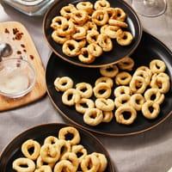
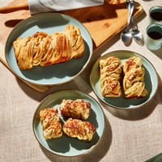

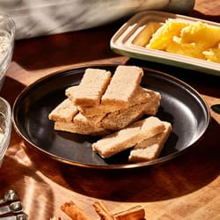
BUTTER Marketing Plan
By Nelson, Brendan, and Jim

Slide 2
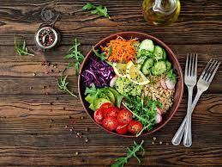
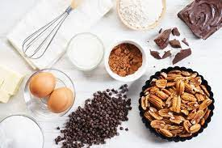

Business Background
BUTTER’s origin is deeply personal
Karen Joy’s history
Vegetarian since 15
“Cooking for self”
Scrutinized so called “healthy” foods/ingredients
Bespoke bakeshop - emphasizes simple ingredients, customization, specialized baking practices that all lead to emphasis of customer satisfaction
Importance? Understanding the past helps shapes the future - operations, growth, and profitability

Slide 3

Mission Statement:
To create delicious baked goods with an emphasis on high-quality ingredients and specialized techniques that will reflect a thoughtful and creative process behind each bake.
In addition to mapping the vision of BUTTER, its conveys a powerful message to the public that promises an exceptional product in an oversaturated market

Slide 4

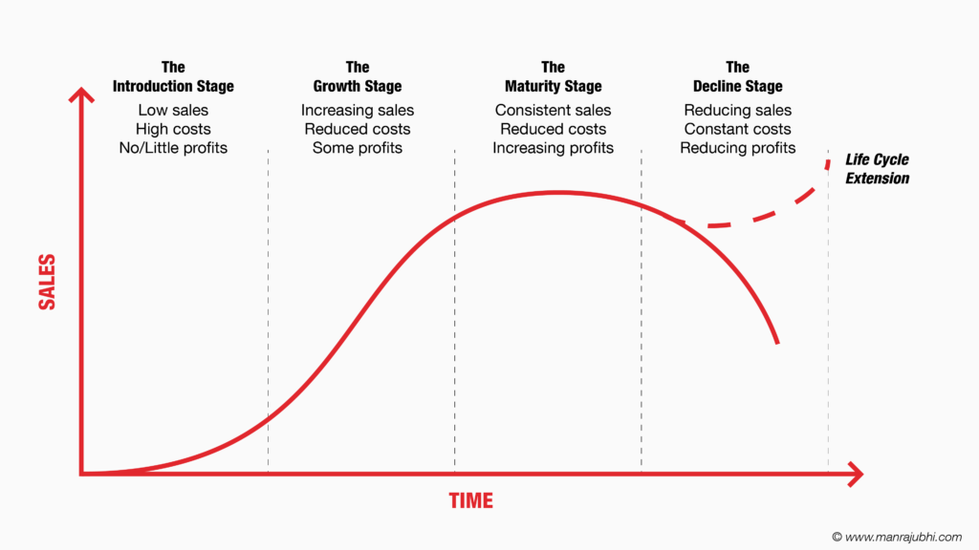
Purpose of this Plan
Defining necessary resources (further elaboration is Marketing Budget section)
Relatively new business, launched in June 2022
4 stages of business growth - introduction, growth, maturity, decline
BUTTER is still in the growth stage, ready to enter the maturity stage
Refined product and small customer base
Understanding trends, market growth opportunities, areas to improve, and areas of success

Slide 5

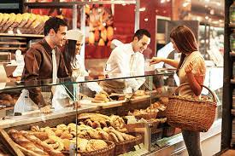
Competitive Advantage - Product Differentiation
Oversaturated market (Walmart/Meijer Bakeries, Sandra Kay, Sweet Dreams, etc.)
Taking advantage of an online presence
Brick and mortar bakeries sell already finished goods
Customers have autonomy in customizing ingredients on the website (Babka offers Baker’s choice, vegan, lactose friendly, gluten friendly)
Cost leadership is ineffective - high price point reflects quality and unique flavor combinations

Slide 6
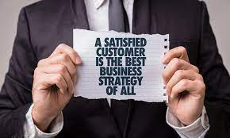

Positioning Statement
Mission statements address a company’s purpose for existing but not the issue of competitive differentiation
Value proposition for existing customers
How does this product benefit the target market?
“For individuals looking for high-quality baked goods with customizable flavor combinations, BUTTER offers a wide range of the most unique options — every finished product creates a positive experience for customers. Unlike other bakeries, BUTTER emphasizes customer involvement and inspires happiness, and the brand is committed on the needs of all its customers.”

Slide 7

Description of target market
Generation Z and Millennial, age 25-44 years old
Working class
Customer that are looking for unique cookie rather than traditional
Willing to try out cottage bakery product
Geographically lives around benton harbor or 30 mins driving distance

Slide 8
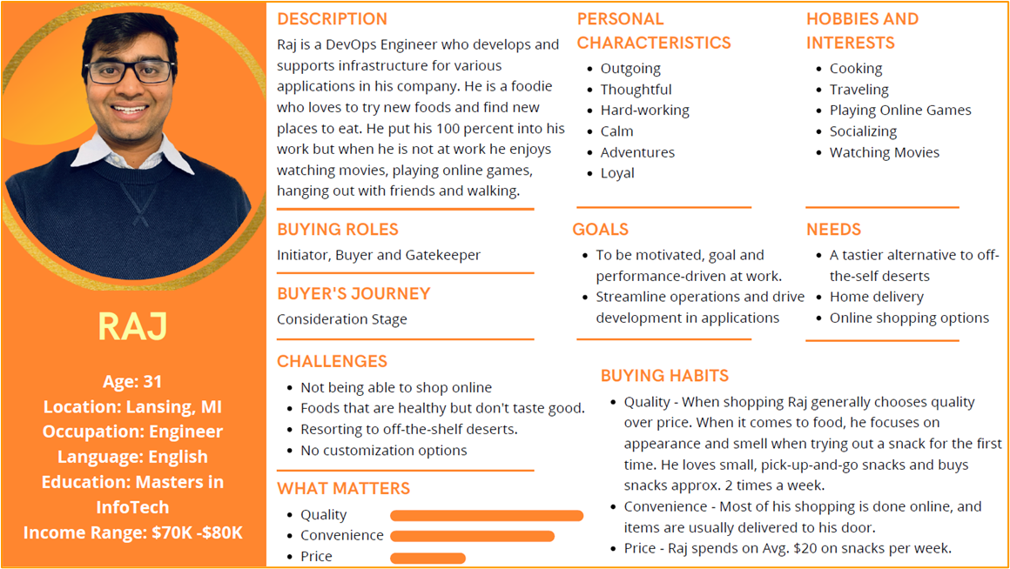
Buyer persona 1

Slide 9
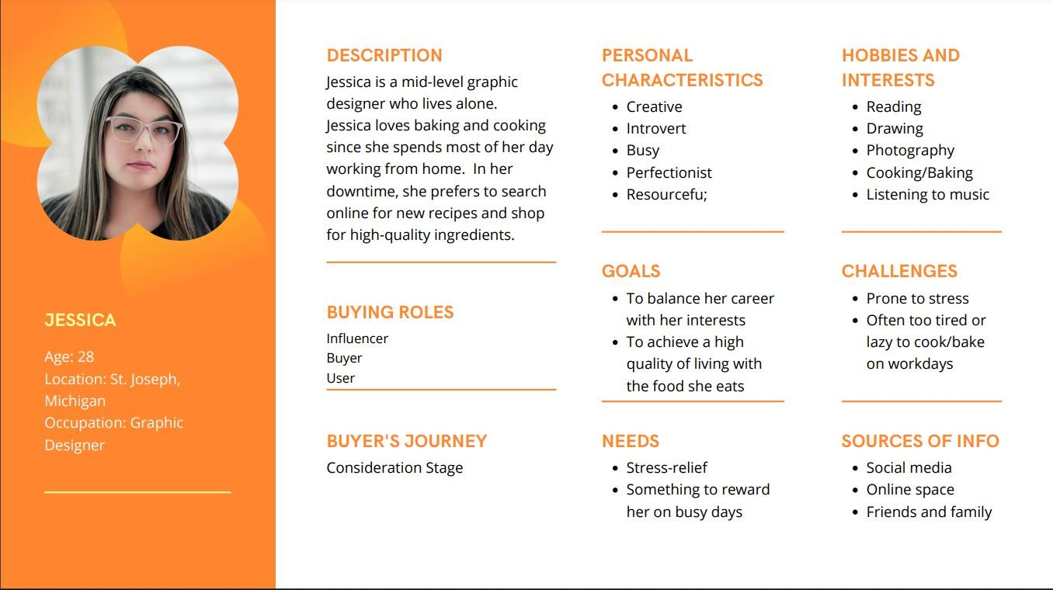
Buyer Persona 2

Slide 10
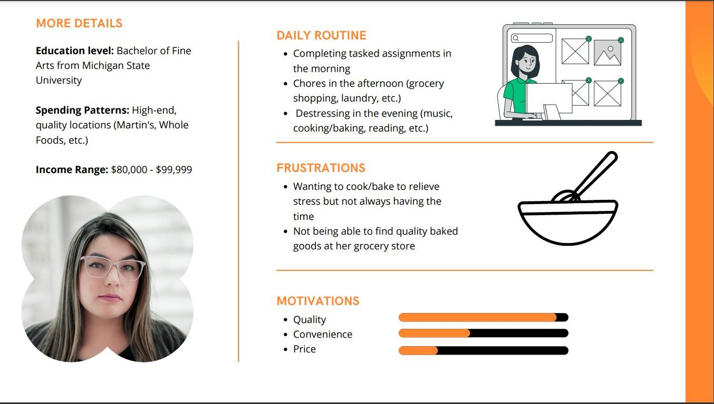

Slide 11
Marketing Objective
Statement: To plan for the product, brand and related services!!!
Execution:
To raise brand awareness on both the internet and neighborhood
Gain exposure to potential customers
Execute competitive advantages over competitors
Retain current customer
Expand available market by allowing customization or increasing product line

Slide 12
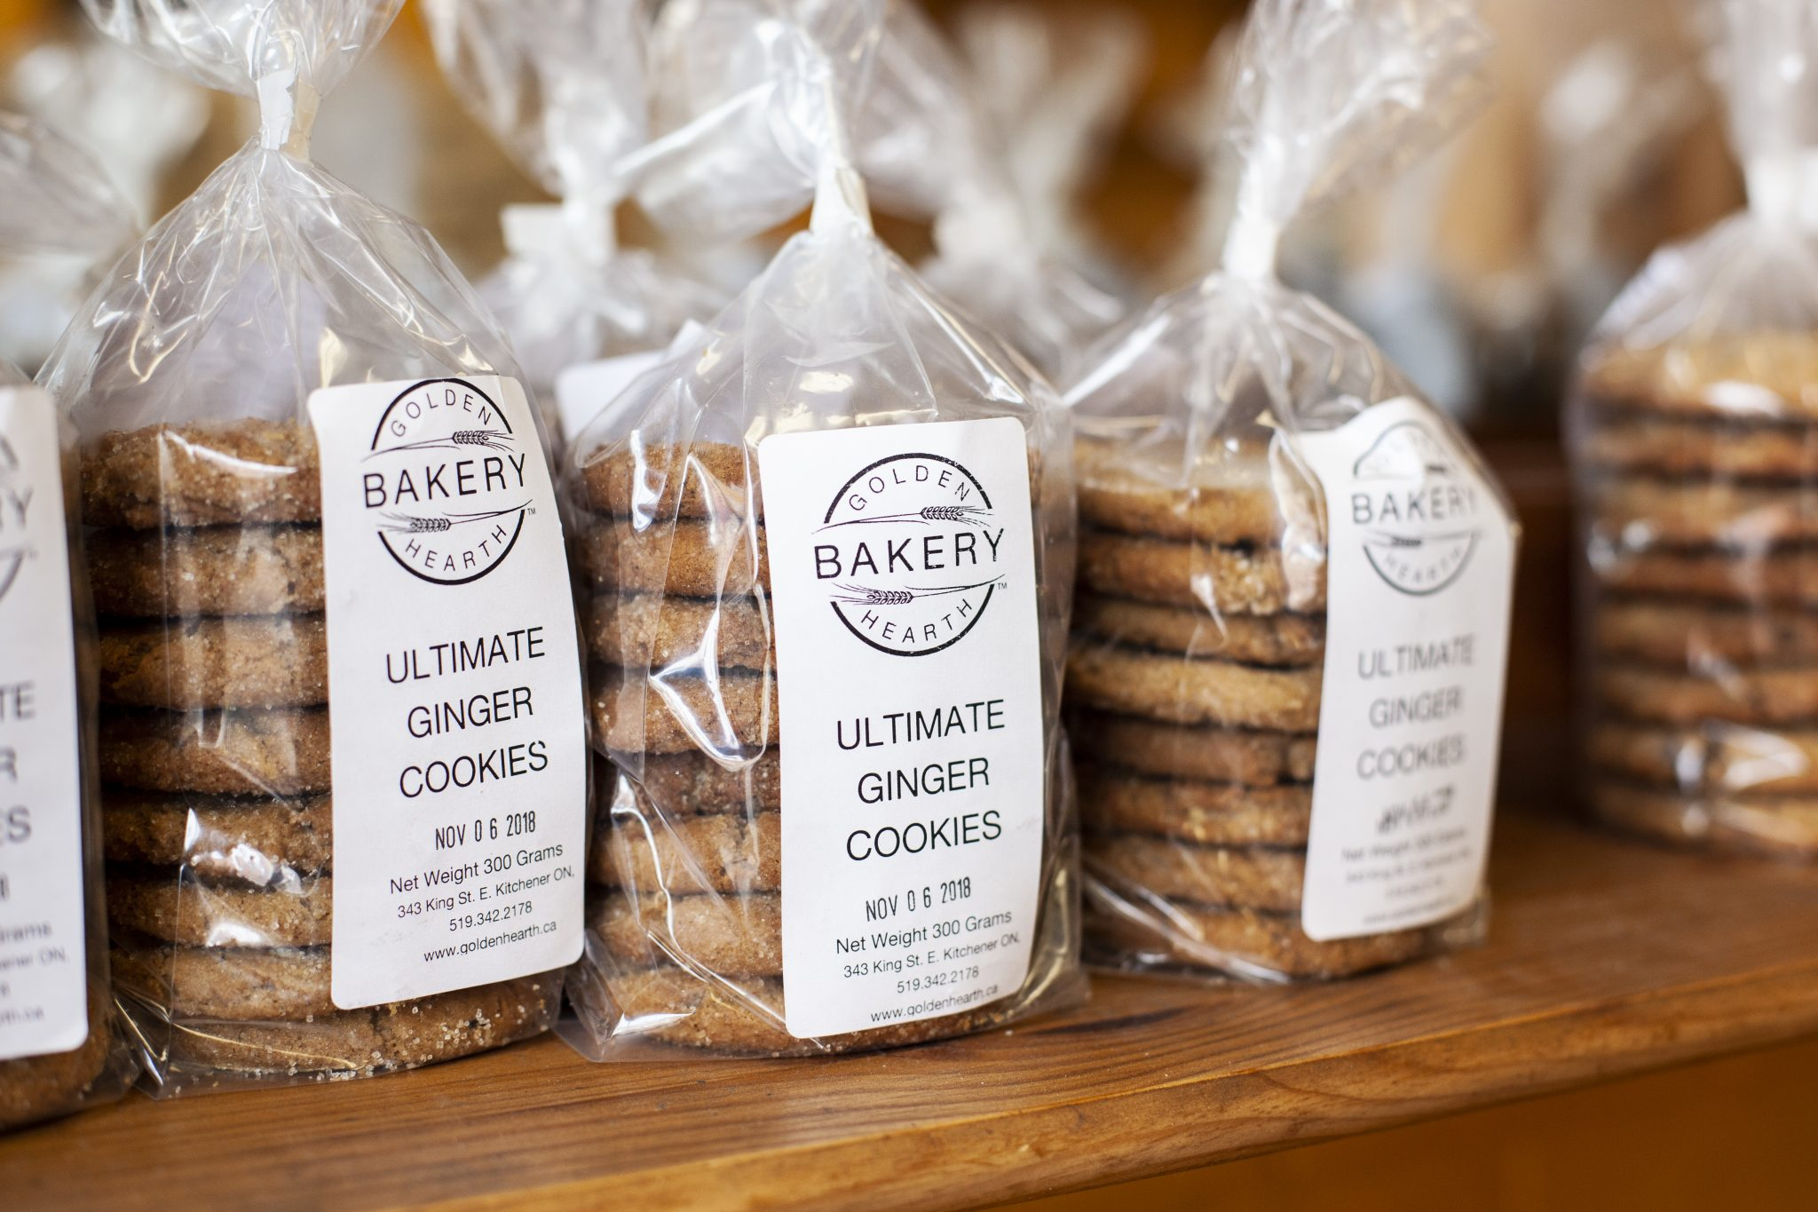
Product strategy
Speciality product - BUTTER 100% hand-crafted with specific baking methods and quality ingredients that set it apart from others.
Customization - The current product line is adequate for local market needs but by accepting customizable order for example adding more flavors or toppings where niche market could be significant.
Flavour combination - Increase the flavour combinations

Slide 13


Pricing strategy
$9 = 9 pieces cookie (With delicate wrapping and packaging)
$1 per each
Focus on moderate to high end pricing strategy as the price somewhat reflect the quality and packaging psychologically to customer.
Skim pricing strategy : Butter is a relative new cookie product to the market considering the ingredients and flavours therefore customer will be intrigued to make a purchase for the first time to retain market base.

Slide 14

Distribution Key Objectives
Three key objectives for distribution:
Create brand awareness
Creating Interest in the brand
Create the want to revisit the brand
Advertising through local newspapers, creating business flyers, being present at food-related events, or even being more active on social media.
Offer sales and discounts, freebies, merchandise, contests, focus on BUTTER’s unique offerings
Customer satisfaction surveys, seasonal emails, active social media, loyalty discounts

Slide 15


Distribution plan
Flyers, Newspapers, leaflets, business cards, promotions, merchandise etc.
How are we going to reach potential customers
Potential Seasonal Discounts/Promotions
Loyalty Discounts OR Referral Discounts
Where are we going to reach potential customers
Word of Mouth & Social Media
Physical distribution locations
Online/Website
Food Fair & Events
FB, Twitter, Instagram, etc.

Slide 16



Media Plan
BUTTER should have its own social media page on at least 2 of these platforms below.
Platform highest stare of users by age:
Facebook 25 - 34 = 23.6%
Instagram 25 - 34 = 27.5%
Twitter 25 - 34 = 38.5%
LinkedIn 25 - 34 = 59.1%
Content suggestions:
Product photographs
How it’s made videos
Offers
Poles
Replies to customer feedback/messages
Social media analytics tools allow you to instantly see trends in sales and interests for your business and other related businesses.

Slide 17

Promotion and Advertising Plan
Top 5 Major Promotion Options for BUTTER:
Website
Social Media
Business Cards
Newspaper
Flyers/Posters

Slide 18

Marketing Budget
The marketing budget for BUTTER is $3000. Goal is approx. $2000.
Marketing Budget Items | Cost | Benefit
Semi-professional photographer (for social media account) | $150 (x7) | Improves the aesthetics of the products.
Flyers | $0.50 (x1500) | Reaches a large number of potential customers
Local Newspaper | $90 (3 inches of black and white space) | Reaches the older generation
Total = $2190 $ Leftover = $810

Slide 19
Marketing Budget
Cost Saving Strategy
Self distribute flyers or leave a stack in high traffic areas where lots of people will come across them.
Create social media content using your own phone camera

Slide 20

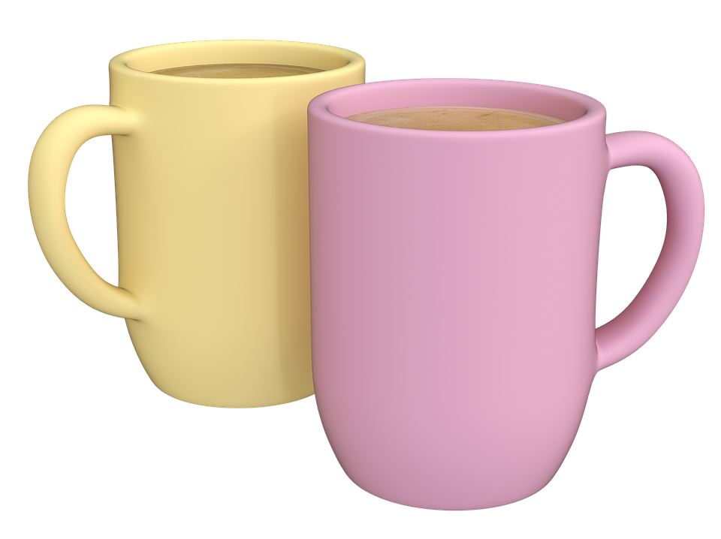


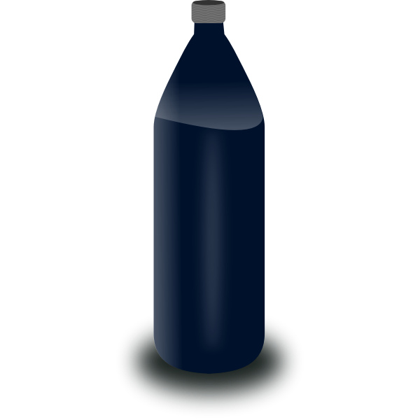

Appendices
Marketing Promotion Items

Slide 21
BUTTER as a brand seeks to be a byword for a unique experience, not just a unique product.

